Slide 1
University of Diyala
College of Engineering
Department of Communications Engineering
Satellite Communications
By:
Dr. Majidah Hameed Majeed

Slide 2
Lecture # 4

Slide 3
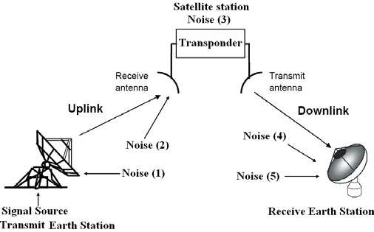
2.6 Noise Considerations in Satellite Comm. Link
Noise can be described as any unwanted electrical signal, it can be divide to:
External noise, it caused by noise source outside the electronic circuits used in the system.
Internal noise , is electrical noise that is generated inside the resistors, transistor , diodes used in amplifier , mixer detectors , ………….etc. this noise called thermal noise .
Fig 2.2
Noise (1): Noise included in signal source plus thermal noise generated by modulator, frequency converter, and power amplifier. In most cases, this noise is sufficiently small compared to signal power and is negligible compared with other noise sources.

Slide 4




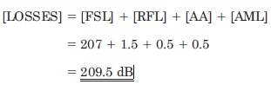
Noise (2): Thermal noise from ground received by satellite antenna (often at 300K).
Noise (3): Thermal noise generated by the satellite transponder and governed by the low-noise performance of the transponder’s first stage.
Noise (4): Noise received by the ground antenna in addition to the signal from the satellite; includes sky noise, atmospheric thermal noise, and terrestrial thermal noise.
Noise (5): Thermal noise generated by the ground receiver and governed by the low noise performance of the first-stage amplifier.
Example ;
A satellite link operating at 14 GHz has receiver feeder losses of1.5 dB and a free-space loss of 207 dB. The atmospheric absorption loss is 0.5 dB, and the
antenna pointing loss is 0.5 dB. Depolarization losses may be neglected.
Calculate the total link loss for clear-sky conditions.
Solution The total link loss is the sum of all the losses:
2.7 equivalent input noise temperatures

Slide 5
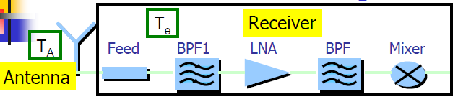
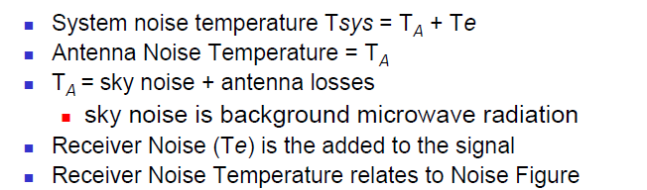

Fig (2.3)
2.7.1 Thermal Noise power �_{𝑵}
Thermal noise power (�� ) generated by resistance at T,
�_{𝑵}= k Ts B (in watts).
k - Boltzmann’s Constant, = 1.38× 10⁻²³ J/K; Ts - noise temperature. is in Kelvin, B is in Hz.
The noise power per unit bandwidth is termed the noise power density. Denoting this by No, then
No = PN / BN = K Ts
spectral
Example
Given
Te = 120 K , gain = 50 dB, frequency = 3.7 GHz to 4.2 GHz Find the internal noise power
Solution

Slide 6
�_{𝑵}= k Te B
Bandwidth = f2 – f1 = 4.2 – 3.7 = 0.5 GHz
Pn = 1.38 * 10⁻²³ * 120 * 0.5 10⁹ 8.28 * 10⁻¹³ w
2.7.2 Signal to noise ration SNR
The quality of electrical signals is generally described by the ratio of signal power to noise power
SNR = ^{𝑷𝑺}and in decibel
𝑷_{𝑵}
SNR = 10 Log ps / pn
Example :
A particular receiver has 0.42 pico w of noise at the input , determine the minimum input signal needed to obtain a 45 dB SNR .
Solution
SNR = ^{𝑃𝑆}and in decibel
𝑃_{𝑁}
SNR = 10 Log ps / pn
45 = 10 Log ps / 0.42 * 10⁻¹²
4.5 = Log ps -12 Log 4.2 Log ps = 13.28 nw
Example : Given :
Input signal = psin = 10 * 10⁻¹⁰ w
input psin
output
pout
External noise = pn1 = 1.12 * 10⁻¹³ w
Amplifier gain G = 1000

Slide 7
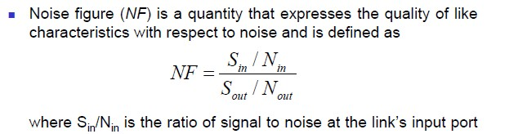
Amplifier BW= B= 27 * 10⁶ Hz Internal amplifier noise = pn2 = 1* Find :
1. Input signal to noise ratio SNR
₁₀−13_{w}
2. Output signal pout , 3. output noise , 4. output signal to noise ratio
Solution
1. SNR = 10 Log psin / pn1 = 10 Log
�∗��
−��
= 29.51 dB
�.��∗��^{−��}
2. Pout = G psin = 1000 * 1 ∗ 10⁻¹⁰ = � ∗ ��^{−𝟕}w
3. Output noise = ( pn1 + pn2 ) * G = ( 1 ∗ 10⁻¹⁰ + 1.12 ∗ 10⁻¹³ ) * 1000
= 2.12 * 10⁻¹⁰ W
���� �∗��
−𝟕
4. O/P SNR = 10 Log = 10 Log = 26.74 dB
������ ��𝐢�𝐞
�.�� ∗ ��^{−��}
2.7.3 Noise figure ( NF)
From the following fig
Ta
G
 | Rx
Ni |  | No
Te
Sin / Ni = Sin / KTa B
Sout / Nout = G Sin / G Ts B

Slide 8

Where Ts = Ta + Te
Also noise figure can be written in term of noise temperature, Te
. Then
Te = To(NF-1)
To , is the reference temperature used to calculate the standard noise figure
usually =290
�_{𝒌}
Example
Then Teff = To( F -1 ) , noise figure must be in linear , 2.7 dB = 1.86
Teff = 290 ( 1.86 -1 ) = 250
�_{𝒌}
, k its kelven degree
Example
An antenna has a noise temperature of 35 K and is matched into a receiver which has a noise temperature of 100 K. Calculate (a) the noise power density
and (b) the noise power for a bandwidth of 36 MHz.
Solution

Slide 9

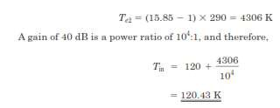
Example
An LNA is connected to a receiver which has a noise figure of 12 dB. The gain of the LNA is 40 dB, and its noise temperature is 120 K. Calculate the overall noise temperature referred to the LNA input.
Solution
12 dB is a power ratio of 15.85:1, and therefore,
2.8 Calculation of System Noise Temperature
Consider first the noise representation of the antenna and the low noise amplifier (LNA) as shown in Fig. 2.4 a. The available power gain of the amplifier is denoted as G, and the noise power output, as No,out

Slide 10
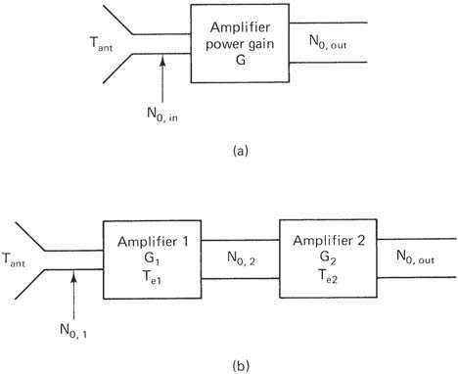



For the moment we will work with the noise power per unit bandwidth,
.
Fig(2.4)
The input noise energy coming from the antenna is
Where K is a degree kelvin not thousand
The output noise energy No,out will be G 𝑁0,𝑎𝑛𝑡
plus the contribution made by the amplifier. Now all the amplifier noise, wherever it occurs in the amplifier, may be referred to the input in terms of an equivalent input noise temperature for the amplifier Te This allows the output noise to be written as

Slide 11


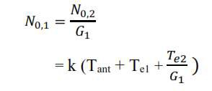
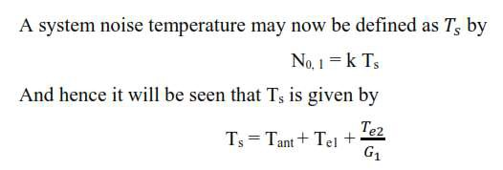
The cascade connection is shown in Fig. 2.4 b. For this arrangement, the overall gain is
The noise energy of amplifier 2 referred to its own input is simply kTe2
The noise input to amplifier 2 from the preceding stages is G1k (Tant + Te1 ), and thus the total noise energy referred to amplifier 2 input is
This noise energy may be referred to amplifier 1 input by dividing by the available power gain of amplifier 1:
This is a very important result. It shows that the noise temperature of the second stage is divided by the power gain of the first stage when referred to the input. Therefore, in order to keep the overall system noise as low as possible, the first stage (usually an LNA) should have high power gain as well as low noise temperature This result may be generalized to any number of stages in cascade, giving

Slide 12

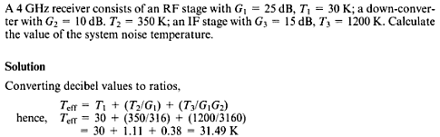
Example
2.9 Carrier-to-Noise Ratio
A measure of the performance of a satellite link is the ratio of carrier power to
noise power at the receiver input, and link-budget calculations are concerned with determining this ratio. Conventionally, the ratio is denoted by C/N (or CNR), which is equivalent to PR/PN. In terms of decibels,
often
C/N = Pr - PN
C = Pr = carrier receiving power Pr = Pt Gt Gr / LF
EIRP = Pt Gt
N = k Ts B Then

Slide 13

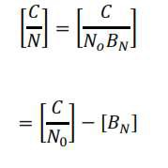
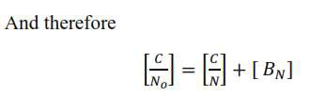
C/N =
Pt Gt LF
.
Gr
𝑇�
.
1
𝐾𝐵
In dB
Noise Density
It is a power presented at 1 KHz bandwidth,
The ratio of carrier power to noise power density may be the quantity actually required then

Slide 14




[C/N] is a true power ratio in units of decibels, and [BN] is in decibels relative to one hertz, or dBHz. Thus the units for [C/No] are dB Hz. Substituting Eq (3.33) for [C/N] gives
2.10 Figure of merit ( G / T Ratio for Earth Station )
This ratio is widely used to specify the quality of an earth station & sat. The antenna gain Gd and the system noise temperature TS can be combined in Eq
Therefore the link equation
becomes
Example
Calculate the overall C/N for a satellite link with the following parameters: Satellite’s EIRP: 45 dBW;
Downlink free-space loss: 205.4 dB (12 GHz); Uplink noise contribution: 0.5 dB;
Additional losses: 0.5 dB;
Receiver ground terminal bandwidth: 20 MHz; Receiver ground terminal (G/T): 20 dB/K.

Slide 15

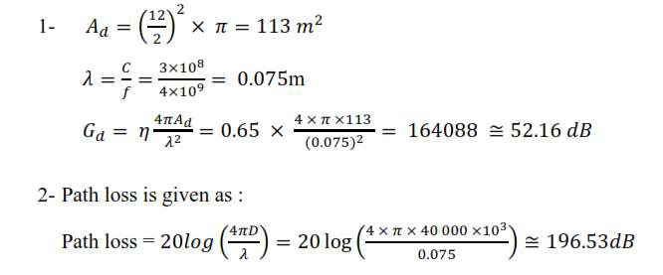
Solution.
The receiver ground terminal bandwidth, expressed in decibels, is
Example Consider a satellite transmitting 25W at a frequency of 4 GHz
via an antenna of 18dB gain. An earth station in the network uses an antenna of 12m diameter with an efficiency of 65%. Assuming the satellite-earth
station range to be 40 000 km. Determine:
1- The gain of the earth station antenna. 2- The path loss (FSL).
The flux density at the earth station.
The power received at the output of the earth station antenna. Ans

Slide 16
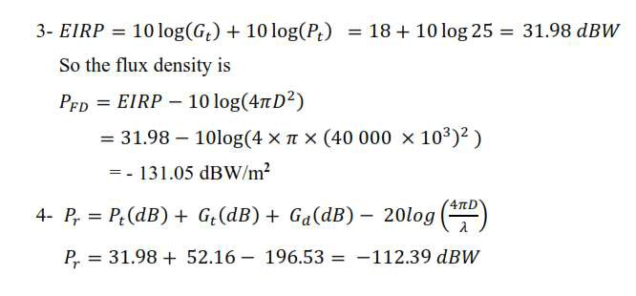
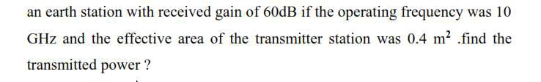
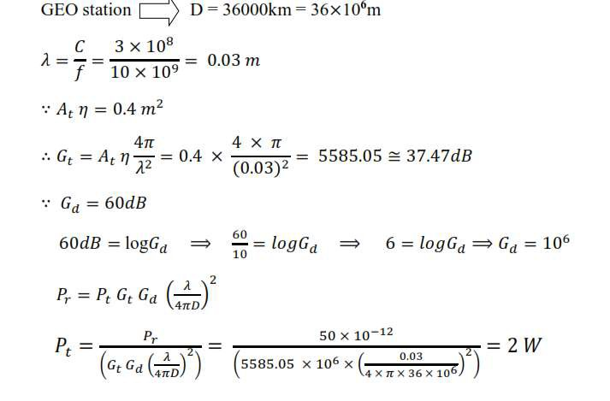
Example :
GEO satellite system having received power of 50 pw from

